Slide 1
REAL ESTATE
IT is a e-commerce website on real estate for to take our first business on new heights.

Slide 2

PRESENTATION ON WEBSITE OF REAL ESTATE
PRESENTED BY-
MUSKAN CHAUDHARY(2100560100063)
PALAK AGRAWAL(2100560100066)
SECTION- CS21
DEPARTMENT NAME- COMPUTER SCIENCE AND ENGG.
COLLEGE- BBDNIIT
SUBMITTED TO-
SAMEER AWASTHI
(ASSOCIATE PROFESSOR)

Slide 3
INTRODUCTION
OBJECTIVE
TECHNOLOGY PLATFORM OVERVIEW
APPLICATION FEATURE OVERVIEW
FUTURE SCOPE
PROS AND CONS
7. SCREENSHOTS OF WEB PAGES
PRESENTATION OUTLINE

Slide 4

INTRODUCTION
●It is a e-commerce website on real estate for to create a clear market position.
● It is a online platform which helps new clients to find their dream home and also for investment purpose.
● Our plan to approach a fulfill the upgrowing demand of today’s scenario and economic growth of the country.

Slide 5
OBJECTIVE
The intention of this website is to provide enough options of properties for potential buyers and renters.
It enable the user to find the best matching property.
This system allows the clients to quickly and easily browse the details of flates and plots with just few clicks.

Slide 6


Technology Platform Overview
●Details of Technology and Software used:
HTML5
VS CODE
Hyper Text Markup Language(HTML). It is the standard markup language for creating websites. HTML5 supports both images and audio.
The software used is VS CODE. It is a code editor redefined and optimized for building and debugging modern web.

Slide 7
FEATURES OVERVIEW
Short term rental properties.
Property listing.
Advertising and Marketing
Visualibility in business.
Find your requirments.

Slide 8
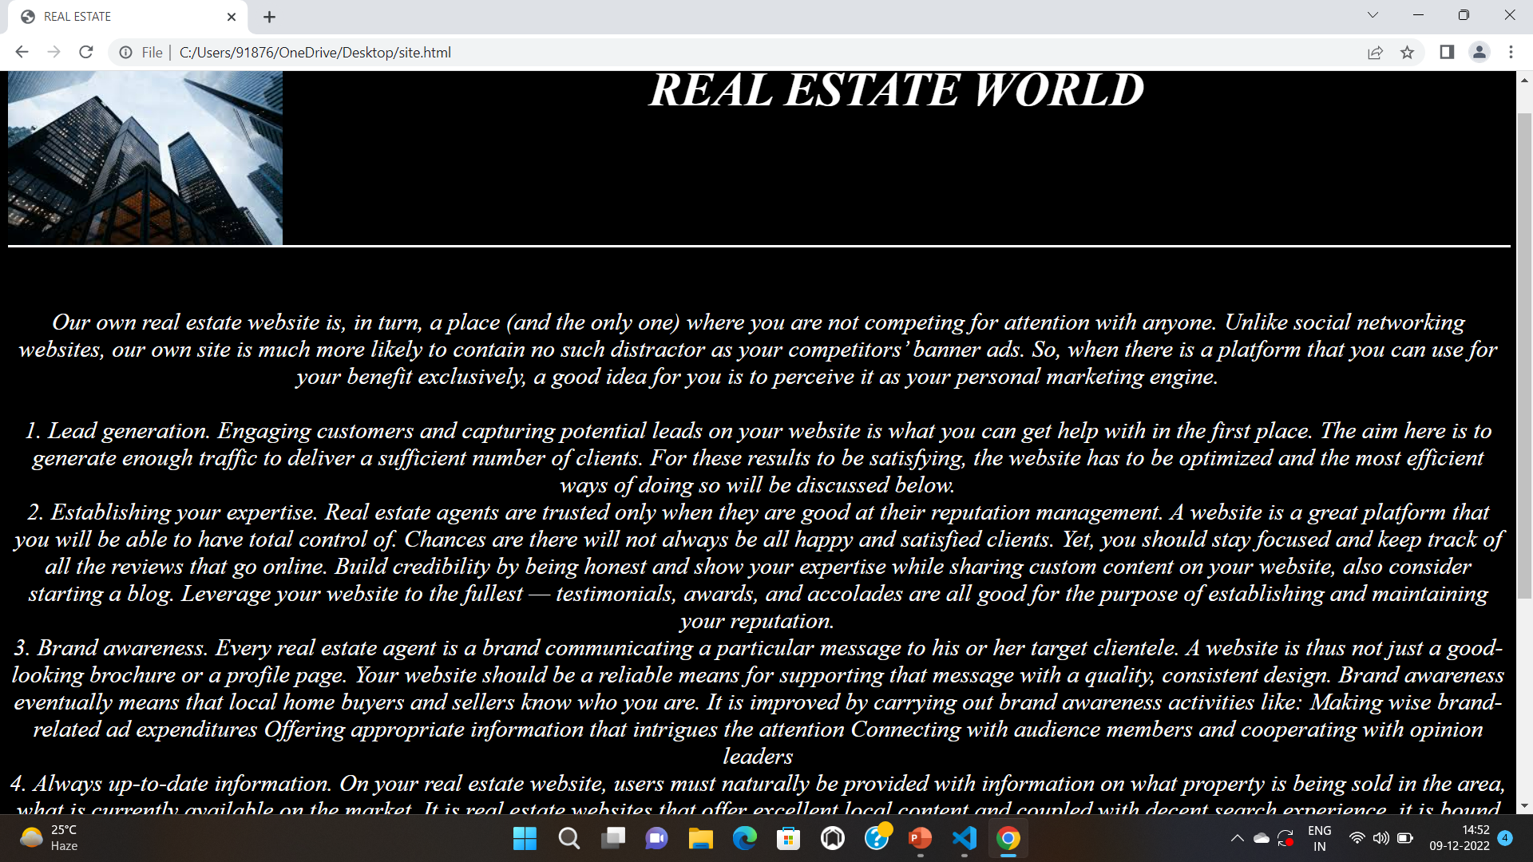
SCREENSHOTS OF WEB PAGES:

Slide 9
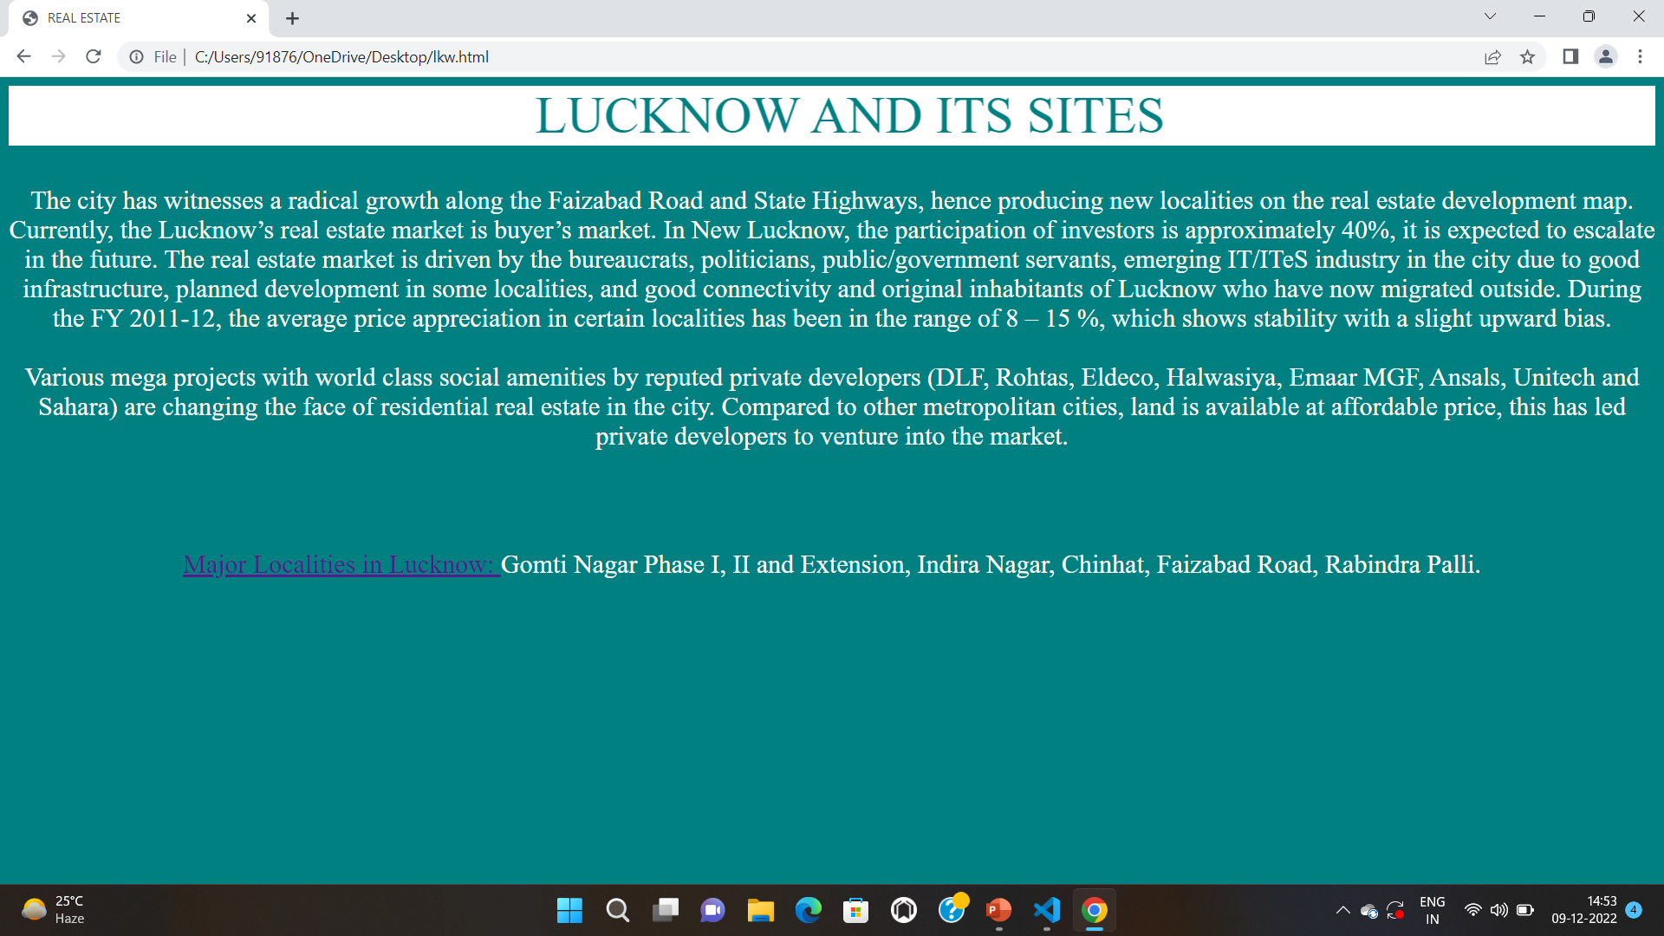

Slide 10
THANK YOU….

